Slide 1
Smart heat, ventilation, and air conditioning (HVAC) system

Slide 2
Inefficiencies of traditional HVAC systems
high energy consumption
lack of adaptation to rapidly changing weather conditions
uncomfortable room temperatures

Slide 3
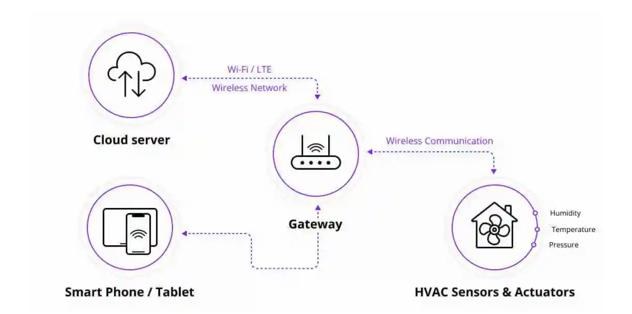
How does smart HVAC system work?

Slide 4
Design process
Research
Prototyping
User testing
Final product

Slide 5
How it is different
Adaptation to user preference
Less energy consumption
Easy control

Slide 6
Future plans
Promotion of larger scale use
Improvement of AI algorithms

